Slide 1
Introduction to Information Systems and Programming
Boolean Satisfiability (SAT)

Slide 2
Logic and Truth Table
Logical conjunction (AND, p ᴧ q, p . q)
p | q | pᴧq
T | T | T
T | F | F
F | T | F
F | F | F

Slide 3
Logic and Truth Table
Logical disjunction (OR, p ᴠ q, p + q)
p | q | p ᴠ q
T | T | T
T | F | T
F | T | T
F | F | F

Slide 4
Logic and Truth Table
Logical implication (p implies q, if p then q, p →q)
p | q | p→q
T | T | T
T | F | F
F | T | T
F | F | T

Slide 5
Distributive Law
For two propositions P and Q:
P ᴧ (Q ᴠ R) <=> (P ᴧ Q) ᴠ (P ᴧ R)
P ᴠ (Q ᴧ R) <=> (P ᴠ Q) ᴧ (P ᴠ R)

Slide 6
De Morgan’s Law
For two propositions P and Q:
¬ (P ᴧ Q) <=> (¬P) ᴠ (¬ Q)
¬ (P ᴠ Q) <=> (¬P) ᴧ (¬ Q)

Slide 7
Activity
Can you show that (i) p →q (ii) ¬p ᴠ q are equivalent?
What is the negation of p →q?
Notes:
Use truth table to show

Slide 8
Boolean Satisfiability (SAT)
SAT: Decide whether there is an assignment to the variables of a Boolean formula such that the formula is true (satisfied)
Yes (if there exists such assignment), satisfiable
No (if all assignments cannot make the formula true)
E.g. consider the formula: f(a,b,c) = (a ᴠ b) ᴧ (¬a ᴠ ¬c), satisfiable or not?

Slide 9
Boolean Satisfiability (SAT)
SAT: Decide whether there is an assignment to the variables of a Boolean formula such that the formula is true (satisfied)
Yes (if there exists such assignment), satisfiable
No (if all assignments cannot make the formula true)
E.g. consider the formula: f(a,b,c) = (a ᴠ b) ᴧ (¬a ᴠ ¬c), satisfiable or not?
(satisfiable, e.g., b=True, c=False)

Slide 10
SAT has a lot of applications
Example: Scheduling under multiple constraints
John can only meet either on Monday, Wednesday or Thursday
Catherine cannot meet on Wednesday
Anne cannot meet on Friday
Peter cannot meet neither on Tuesday nor on Thursday
Question: When can the meeting take place? (or can the meeting take place?)
Encode into Boolean formula:
(Mon ∨ Wed ∨ Thu)∧(¬Wed) ∧(¬Fri) ∧(¬Tue ∧ ¬Thu)
Assignment (Mon,Tue,Wed,Thu,Fri)=(T,F,F,F,F) can satisfy the formula, i.e., meet Monday
Notes:
If meet on Monday, M=True, other: T, W, Thu, F = false
Satisfy john: (M V W V Thu) is True
Satisfy everyone: whole boolean formula is true

Slide 11
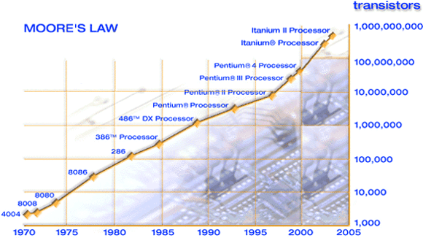
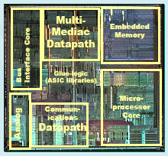
SAT has a lot of applications
Hardware verification (1,000,000,000 transistors processor) [2D Project]

Slide 12
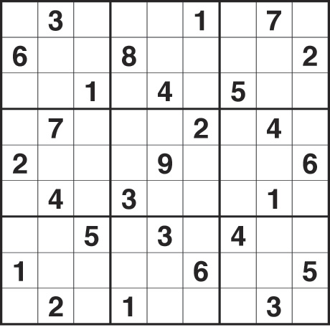
SAT has a lot of applications
Solving Sudoku puzzle
http://www.youtube.com/watch?v=rdftOloAH9Q

Slide 13
Activity
Is this Boolean formula satisfiable?
(P∨Q)∧(¬P∨R)
Notes:
Use truth table to show

Slide 14
Propositional (Boolean) Formula
Propositional (Boolean) formula f is defined over a set of propositional variables x1, . . . , xn, using the standard propositional connectives ¬, ∧, ∨, → and parenthesis
The domain of propositional variables is {0, 1}: 0=False, 1=True
Example: f(x1, x2, x3) = ((¬x1 ∧ x2) ∨ x3) ∧ (¬x2 ∨ x3)
A formula f in conjunctive normal form (CNF) is a conjunction of disjunctions (clauses) of literals, where a literal is a variable or its complement
Example: f(x1, x2, x3) = (¬x1 ∨ x3) ∧ (x2 ∨ x3) ∧ (¬x2 ∨ x3)
Can encode any Boolean formula into CNF
Notes:
How to convert a boolean formula into cnf?

Slide 15
SAT Solver
Program that takes a Boolean formula in conjunctive normal form (CNF)
Returns an assignment, or says none exists (satisfiability: yes / no)
Straight forward approach: enumerate all assignments, check formula for each
For n variables, 2^{n} assignments!
Can we do better?

Slide 16
SAT Solver
Unfortunately, it is generally believed that can’t do better in the worst case (not proven)
SAT was the first known example of an “NP-complete” problem
Cannot be solved in polynomial time in any known way
No known algorithm that efficiently solves all SAT instances
It is generally believed that no such algorithm can exist (not proven)
That is, hard problem
Fortunately, a large enough subset of SAT can be solved efficiently (but no solver can efficiently solve all SAT instances)

Slide 17
SAT Solver Representation
one way to represent boolean formulas:
Formula = Var(name: String)
+ Not(formula: Formula)
+ Or(left: Formula, right: Formula)
+ And(left: Formula, right: Formula)
(P∨Q)∧(¬P∨R) would be :
And( Or(Var(“P”), Var(“Q”)),
Or(Not(Var(“P”)), Var(“R”)) )
(Socrates → Human) ∧ (Human → Mortal) ∧ ¬ (Socrates → Mortal) would be:
And( Or(Not(Var(“Socrates”)), Var(“Human”)),
And ( Or(Not(Var(“Human”)), Var(“Mortal”)),
Not( Or(Not(Var(“Socrates”)),Var(“Mortal”)))))

Slide 18
SAT Solver
Based on conjunctive normal form (CNF) or “product of sums”
(P∨Q)∧(¬P∨R) is in conjunctive normal form:
set of clauses, each containing a set of literals {{P, Q}, {¬P, R}}
literal is just a variable, maybe negated
can only negate variables, and not clauses

Slide 19
Basic backtracking algorithm using CNF
CNF is a product of sums: we need every clause true, and at least one literal in each clause
backtracking search: pick a literal, try false then true
if clause set is empty, success
if clause set contains empty clause, failure
systematic way of enumeration

Slide 20
Basic backtracking algorithm using CNF: Important observations
In a CNF, if one of the clauses is false, the entire formula is always false (back-tracking)
In a clause, if one literal is true, the entire clause can be removed, as it does not affect the truth value of the entire formula (formula simplification)
In a clause, if one literal is false, the literal can be removed, as it does not affect the truth value of the clause (formula simplification)

Slide 21
Basic backtracking algorithm using CNF
Example: satisfiability of
(Socrates → Human) ∧ (Human → Mortal) ∧ ¬ (Socrates → Mortal)
CNF:
(¬ S ∨H) ∧ (¬H ∨ M) ∧ S ∧¬M
Shorthand:
{SH}{HM}{S}{M}
(underlines mean negation)

Slide 22
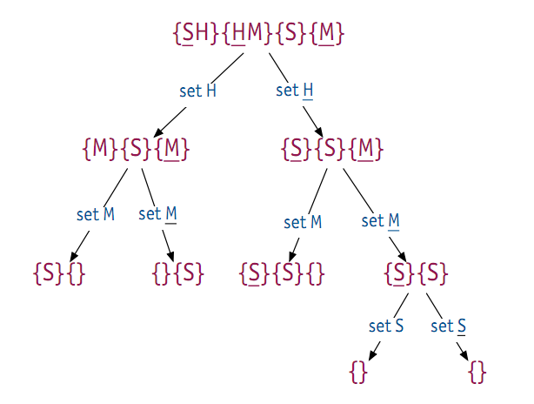
Basic backtracking algorithm using CNF
Set H in {HM}, now depends on M
Set M, {M} will fail definitely (rep. as {}). Formula cannot be satisfied.
Notes:
No need to try more;
H must be set, into true or false. But either way, false in one clause, i.e., false in entire formula
So formula cannot be satisfied.
With backtracking, no need to try all, e.g. set H -> set M, not M -> set S, not S; but no need to test S in the LHS, because fail definitely.

Slide 23
Basic backtracking algorithm using CNF
Node contains {} -> fail to satisfy
A empty node -> succeed (found one assignment that satisfies the formula)
In this case, all paths fail, so formula is not satisfiable
Worst case: number of leaves = 2^(num_of_literals)

Slide 24
DPLL: Classic SAT algorithm
Key idea: unit propagation on top of backtracking search
If a clause contains one literal, set that literal to true
Necessary for any satisfiable assignment

Slide 25
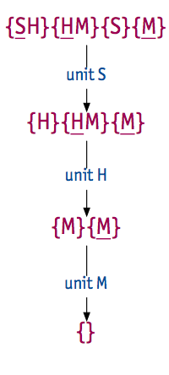
DPLL: Classic SAT algorithm
In this case, no splitting needed
Propagate S, then H, then M
Much faster, but worst case is still exponential

Slide 26
Activity
Is the following propositional formula of Boolean variables A, B, C, D satisfiable? Give detail explanation and derivation
(¬A ∨ B) ∧ B ∧ (¬B ∨ C) ∧ (¬C ∨ D) ∧ (¬D)

Slide 27
Activity (solution)
Can you show that (i) p →q (ii) ¬p ᴠ q are equivalent? (ans: by truth table)
What is the negation of p →q?
p ^ ¬q
Notes:
Use truth table to show

Slide 28
Activity (Solution)
(P∨Q)∧(¬P∨R)
{P = false, Q = false, R = false}
{P = false, Q = false, R = true}
{P = false, Q = true, R = false}
{P = false, Q = true, R = true}
{P = true, Q = false, R = false}
{P = true, Q = false, R = true}
{P = true, Q = true, R = false}
{P = true, Q = true, R = true}
Notes:
( ) ^ ()
Each must be true
Since “V” inside, need at least one true, e.g. P=true, R=true

Slide 29
Activity (solution)
Is the following propositional formula of Boolean variables A, B, C, D satisfiable? Give detail explanation and derivation
(¬A ∨ B) ∧ B ∧ (¬B ∨ C) ∧ (¬C ∨ D) ∧ (¬D)
Not satisfiable

